Slide 1

National Institute of Technology, Calicut
Vivir – Make Your Stay Easy
Mentor : Presented by -
Dr. Sudeep K S Yogendra – M150480CA
CESD, NIT Calicut MCA - Sixth Semester

Slide 2
Content:
Introduction
Background and Motivations
Literature Survey
User Classes and Major Functionalities
1 - Tenant
2 - Owner
Minor Functionalities
Rough implementation plan
Operating and Development Environment
1 - Client Side Requirement
2 - Server Side Requirements
References

Slide 3
Introduction -
Vivir is an android application for solving the daily life “House Rental and Tenancy” problem. It provides functionalities to Search, Book/Rent and perform activities needed during stay.
Major Users –
Tenant(Renter)
Owner

Slide 4
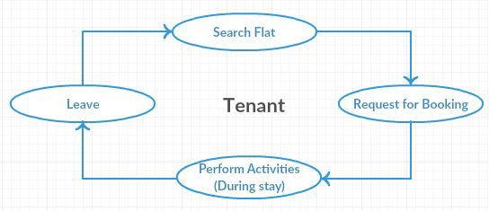
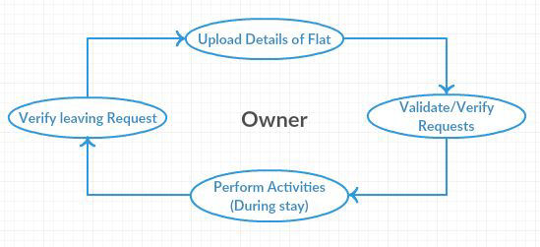
Tenant
Owner

Slide 5
Background and Motivations :
Vivir is, aimed to replace the existing manual Searching /booking of flats/ rooms and activities associated with that.
How it is useful ?
To Tenant :
Easy and efficient searching and booking of flats/rooms.
Removes the conflicts of rent payment and memorization of due date.
Makes the communication with owner easier.

Slide 6
To Owner :
Application will provide an easy way to let their property.
Approaching to the Customer/Tenant would be easier and efficient.
Complaint handling and communication with Tenant would be easier.
Timely payment of rents and no need to memorize/note anything, application will automatically give notifications to both peers.

Slide 7
​
To Social Aspect :
Cost and time efficient, needs only an internet connection and Android phone.
Will help in maintaining the good relationship between Tenant and Owner.
Transparency of rent and price.

Slide 8
Literature Survey -
Manual booking and Tenancy.
Booking Agencies and commission agents.
Online Websites.
Working with Android application makes the Booking and Tenancy more easier. It just needs an android phone and internet connection.

Slide 9
User Classes and Major Functionalities
The project will accomplish the following functionalities. The major user classes and their associated functionalities are -
Tenant :
● Registration and Login
● Searching
● Booking
● Payment Details upload
● Complain
● Notifications
● Communication(Messaging)
● Leave Flat

Slide 10
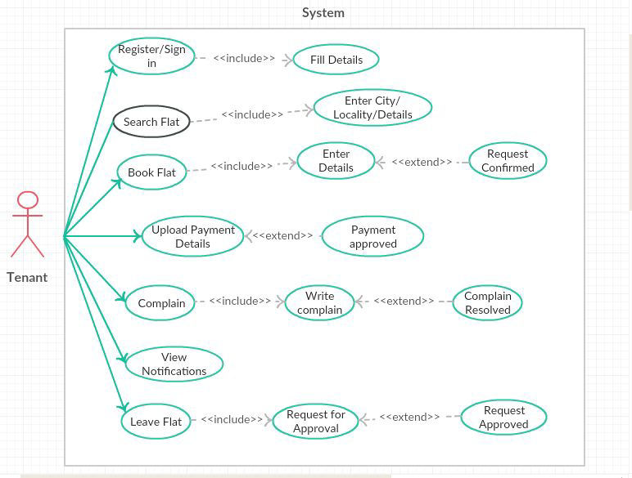
Use Case diagram : Tenant

Slide 11
Owner :
● Registration/Login
● Upload Flat/Room details
● Approve Booking Request
● Approve Payment Details
● Resolve complaints
● View Notifications
● Verify Requests(leaving..)

Slide 12
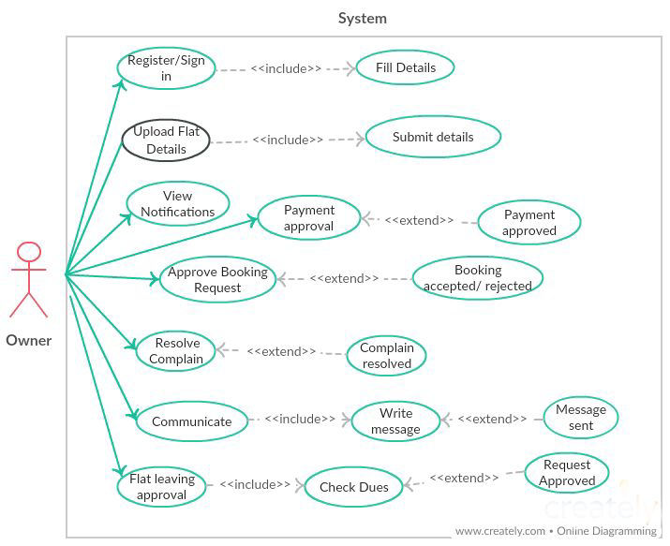
Use Case Diagram : Owner

Slide 13
Minor Functionalities :
These are the supporting functionalities for maintaining the accurate system flow.
● User Profile setting
● Deleting and updating records
● Change password
● Details managing

Slide 14
Rough implementation plan :
Project will be devised by taking care of following aspects and standards.
Android Material design - For designing and creating the user interface.
Specific Algorithm and Data Structure – To provide best result and good response time.
Relational Database Concepts - To model and design the database.
Coding Standard : Java Coding Convention
Global Database – MySQL and Local Database - SQLite

Slide 15
Operating and Development Environment
Client Side Requirement
Operating System : Android OS (android 4.0 and above)
Connectivity: Good Internet connection
Server Side Requirements
Operating System : Linux/Windows/Mac
Development Platform: Android Studio and JVM
Database : MySQL and SQLite

Slide 16
References :
These references are being used in whole project development.
● Android Studio: http://developer.android.com/studio/index.html
● Udacity : https://in.udacity.com/
● Java - The Complete Reference by Herbert Schildt
● XML - www.tutorialspoint.com
●Java Code Conventions - http:// www.oracle.com/ technetwork/ java/ codeconventions-150003.pdf

Slide 17
Thank You

